Slide 2
Dental Risk Management Strategies
Rodney B Wentworth, DDS, FACD October 18, 2023
Risk Management Strategies for Three Important Topics

Slide 3
A few things I’ve been fortunate to do
General Dentist private practice, UW SoD grad 1981
Affiliate faculty Dept of Oral Medicine
Lecture/teach Ethics and Professionalism, Dental Jurisprudence
UW Curriculum Committee Overseeing Ethics/Professionalism /JurisprudenceThread in UWSod curriculum
WHI “The Dentist Program” RRG Malpractice company founding dentist, underwriting committee
Past NORDIC Claims Committee member
Past Chair ADA Council on Ethics, Bylaws, and Judicial Affairs, Chair WSDA Judicial Affairs, Ethics and Peer Review Committee, Chair SKCDS Ethics Committee
Contributing author JADA “Ethical Moment”
Past WSDA president

Slide 4
Who is WHI and The Dentist Program?
Washington Healthcare Insurance Company, A Risk Retention Group (WHI)
  Dba of California Healthcare Insurance Company, Inc., A Risk Retention Group (CHI)
  Professional liability insurance company owned by its policyholders
CHI started “The Dentist Program” in 2018 with the support of 4 “founding” Washington dentists
  Provides dentist professional liability for dentists in Washington and Oregon
  2022 is the 5th year of loyalty payment distributions under the program
    2018 = 11%
    2019 = 17%
    2020 = 21%
    2021 = 12%
    2022 = 12%

Slide 5
Outline
Malpractice statistics/risks
Informed consent
Record keeping
Strategies to prevent and respond to patient complaints
When things go wrong
Terminating the Doctor/Patient relationship

Slide 6
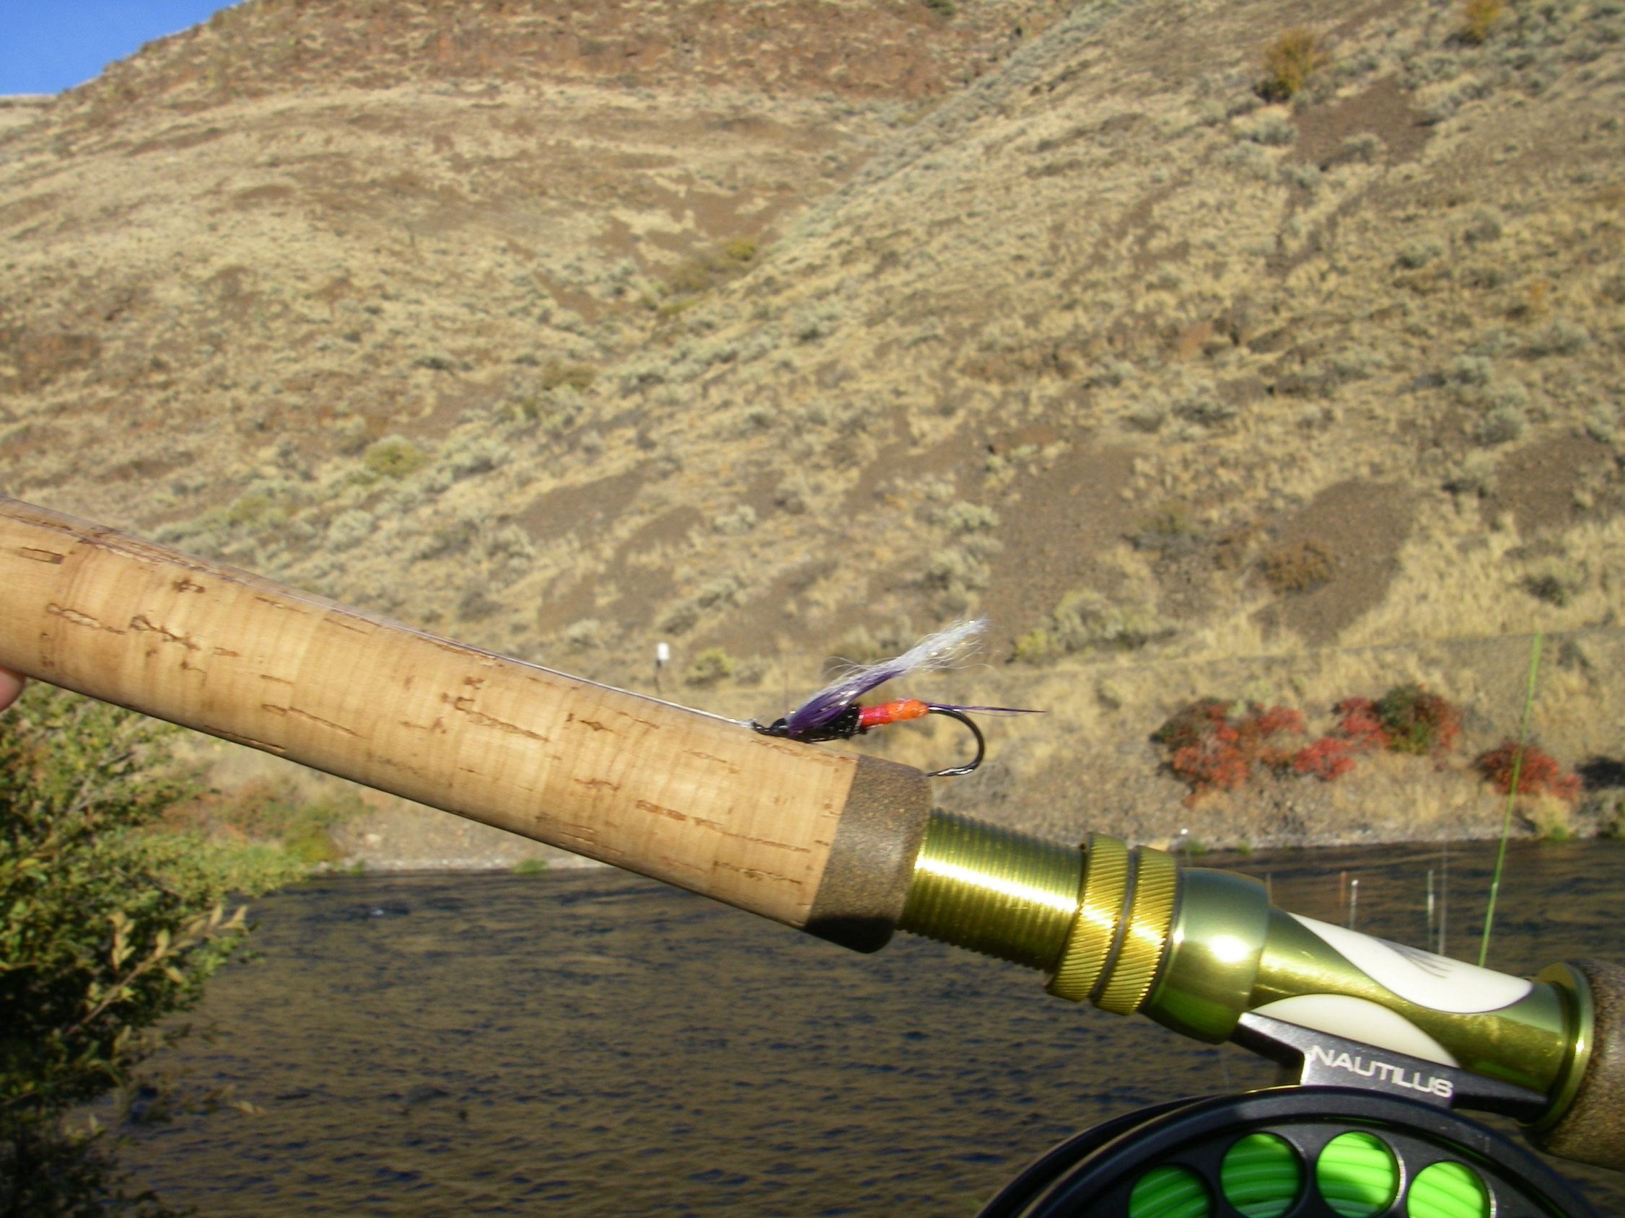
Notes:
We’re going to talk about risk management today. You are also going to learn a bit about fly fishing and maybe be introduced to some fish you are not familiar with.

Slide 7
Malpractice Statistics
From NPDB 2010-21. 139,774 individual medical malpractice payments reported across all medical specialties.
Of these claims payments, dentists and dental hygienists were responsible for 16,118 —roughly 11.5%.
  It does not include the number of claims filed, adverse actions, lawsuits in which providers were dismissed, or any other type of incident that might require defense expenses.
  Source: https://www.berxi.com/resources/articles/dental-malpractice-stats/

Slide 8
Malpractice Statistics
Washington State 2017-21 3507 claims (medical and dental)
46.1% resulted in payment (average $493,786)
  $798 million in 1,617 claims
  13.4% greater than $1M
  Longer the claim went on the higher the payment
Defense costs: $229 million to defend 3018 claims
  $74,325 per claim
  https://www.insurance.wa.gov/sites/default/files/documents/2022-medical-malpctice-annual-report

Slide 9
Malpractice Statistics
Washington State 2017-21 259 Dental group or practice claims
  45.6% resulted in payment (average $115,870)
  Average defense costs $28, 492
Washington State 2017-21 263 Dental specialty claims
  46% resulted in payment (average $115,870)
  Average defense costs $30, 448
  https://www.insurance.wa.gov/sites/default/files/documents/2022-medical-malpctice-annual-report

Slide 10
Reasons for Claims
Improper crown/bridge placement
Prescribing incorrect drugs or dosages
Improper tooth extractions
Endodontic procedures
Orthodontic treatment complications
Improper treatment after procedures
Failure to diagnose oral health issues
Dental anesthesia complications
  Source: https://www.berxi.com/resources/articles/dental-malpractice-stats/
  September 2023

Slide 11
Why Do Patients Sue
Poor outcome (Error or improper performance)
  Failure to Diagnose
  Failure to refer
  Cause additional damage during treatment (eg root fracture)
  Cosmetic appearance
  Retained instruments
  Treatment failure
  Infections
  Implants (multiple)
  Anesthesia issues
  Nerve injuries
Source: Michael McDermott, JD

Slide 12
Why Do Patients Sue
Behavior (Bedside manner)
Delay in performance
Communication
  Don’t promise, watch advertising, make an apology
Financial incentive
  Billing confusion, insurance percentage, sent to collections
Criticisms by subsequent providers/specialists
  Choose words carefully
Failure to refer
  When in doubt, refer it out
Poor supervision
Source: Michael McDermott, JD

Slide 13
Risks for Claims
Failure to Obtain Consent
  Document IC
Failure to Diagnose
  Document, Oral cancer screen on all, routines
Failed Treatment
Questionable Advice
  Document discussions, ask pt. to repeat so no misunderstandings
Nerve Damage
  Source: https://www.berxi.com/resources/articles/dental-malpractice-stats/
  September 2023

Slide 14
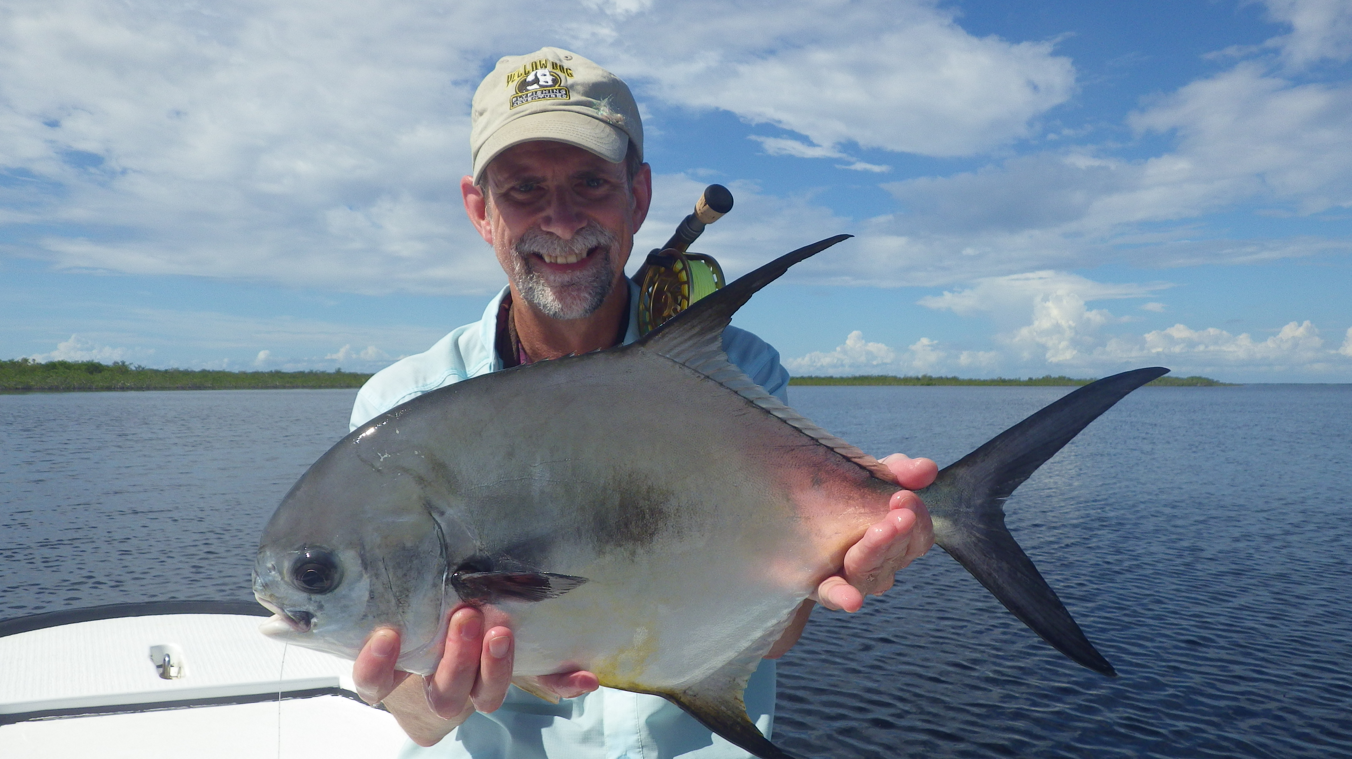
Notes:
Anyone know what kind of fish this is? Note the smile on my face. This is the holy grail of saltwater fly fishing.

Slide 15
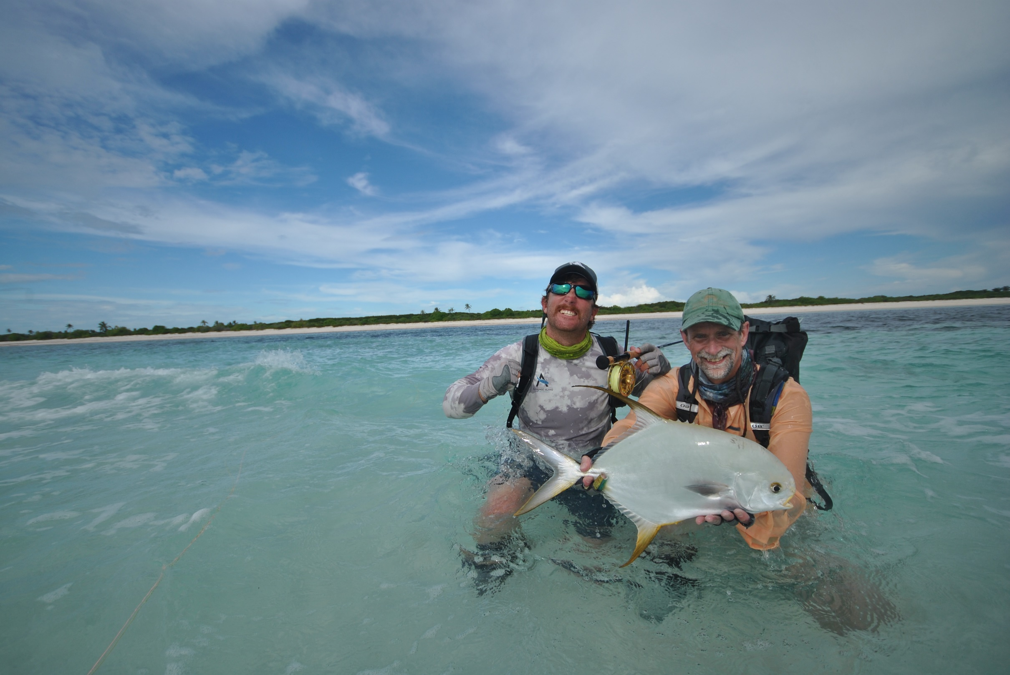

Slide 16
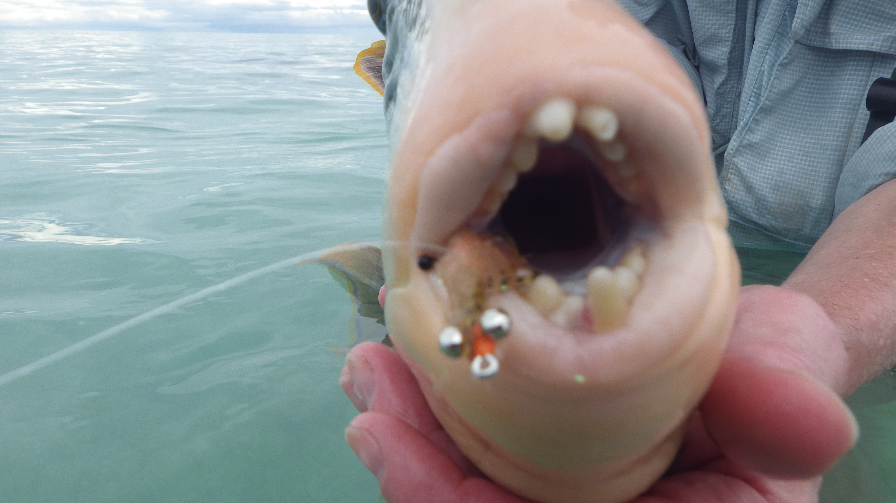
Notes:
You know we don’t let you treat real people until you get some practice on other teeth.

Slide 17
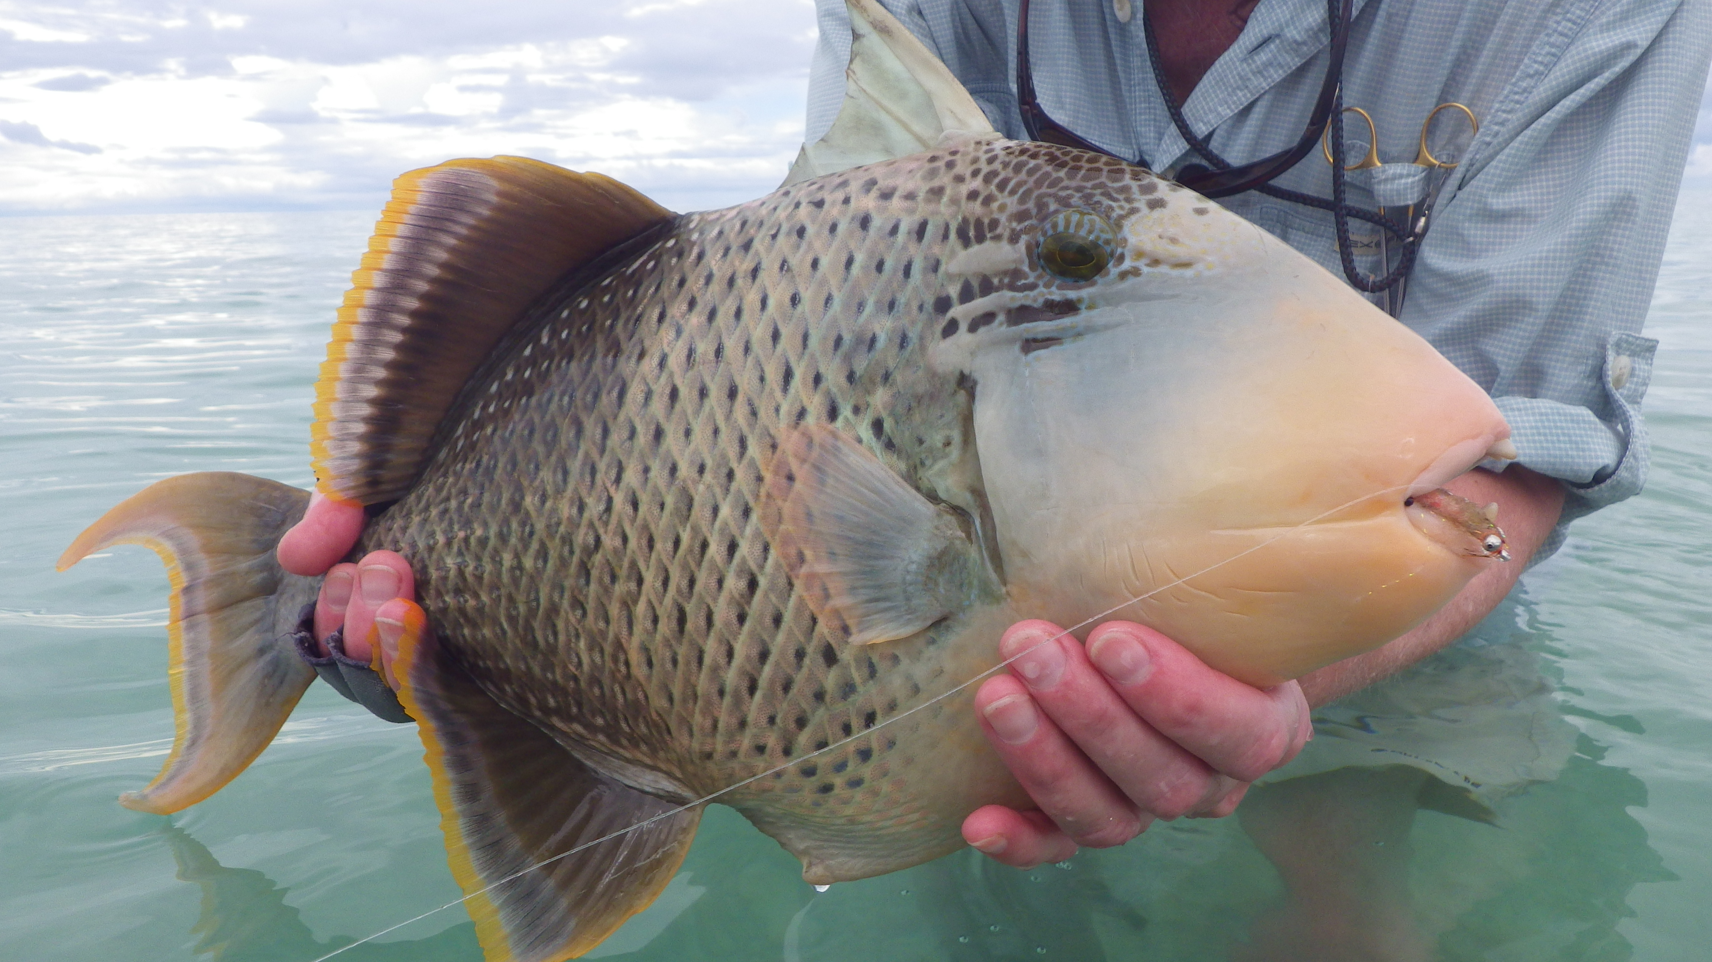

Slide 18
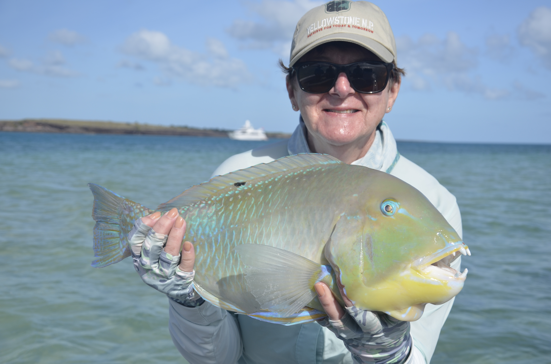
Notes:
This is a Black spot Tusk Fish

Slide 19
Notes:
This is Jenny with her Black spot Tusk Fish. Fly fishing is like dentistry….There are no gender differences in regard to skill levels and ability to achieve excellence .

Slide 20
Informed Consent
30-35% of claims involve informed consent allegations
P-A-R-B-Q (procedure, alternatives, benefits, risk, questions
Use procedure-specific forms
Document consent process and any educational materials provided to patient
Have staff present, if possible

Slide 21
Informed Consent-The Law
OAR 818-001-0002
Definitions (10) "Informed Consent" means the consent obtained following a thorough and easily understood explanation to the patient, or patient's guardian, of the proposed procedures, any available alternative procedures and any risks associated with the procedures. Following the explanation, the licensee shall ask the patient, or the patient's guardian, if there are any questions. The licensee shall provide thorough and easily understood answers to all questions asked.

Slide 22
Informed Consent-The Law
OAR 818-012-0070 Patient Records (must include)
(1) (c) An entry that informed consent has been obtained and the date the informed consent was obtained. Documentation may be in the form of an acronym such as “PARQ” (Procedure, Alternatives, Risks and Questions) or “SOAP” (Subjective Objective Assessment Plan) or their equivalent.

Slide 23
Parental Consent
If a parent represents that they are authorized to consent, then the healthcare professional can accept consent without incurring liability.
  true regardless if the parents are married, divorced, separated, or the consenting parent is not the custodial parent
RCW 70.02.130

Slide 24
Minor Consent
Age of Consent is 18
ORS 109-640: A minor 15 years of age or older may give consent, without the consent of a parent or guardian of the minor, to: (a) Hospital care, medical or surgical diagnosis or treatment by a physician licensed by the Oregon Medical Board, and dental or surgical diagnosis or treatment by a dentist licensed by the Oregon Board of Dentistry, except as provided by ORS 109.660.

Slide 25
Informed Consent for Minors
Persons authorized to provide consent:
  Parents
  Guardian/legal custodian appointed by court
  Person given written permission by parents
  Competent adult that is a relative (by declaration)

Slide 26
Capacity vs Competence
Competency is a legal determination with court documentation
Capacity is the ability to understand
  If one lacks the capacity to understand you will not be able to satisfy informed consent
  Dentist obligation to make that determination
  Consider surrogates?
    Spouse
    Siblings

Slide 27
Surrogate Decision Maker - Hierarchy in Washington
Identifying the surrogate - If not specifically identified, WA statute makes this easier than some states for sequential hierarchy of surrogates:
  Court Appointed Guardian
  Durable Power of Attorney (DPOA)
  Surrogate Order in WA State:
    Partner or spouse
    Adult child(ren)
      Requires consensus amongst children
    Parents (does not define 'parent')
      Requires consensus
    Adult sibling(s)
      Requires consensus amongst siblings
https://app.leg.wa.gov/rcw/default.aspx?cite=7.70.065

Slide 28
Surrogate Decision Maker - Hierarchy in Oregon
The order for who will decide is:
      A guardian appointed by the state
      Named health care representative with health care decision-making authority in the advance directive
        Your spouse or registered domestic partner
            (even if separated)
          An adult designated by others on this list, without objection by anyone on list
            Your adult children *
              Your parent
                Your adult siblings *
                Your adult relative or close friend
        *Adult Children &Siblings: majority rule. Judicial recourse not addressed
Att. Physician (includes naturopathic physicians)
Source honoringchoicespnw.org

Slide 29
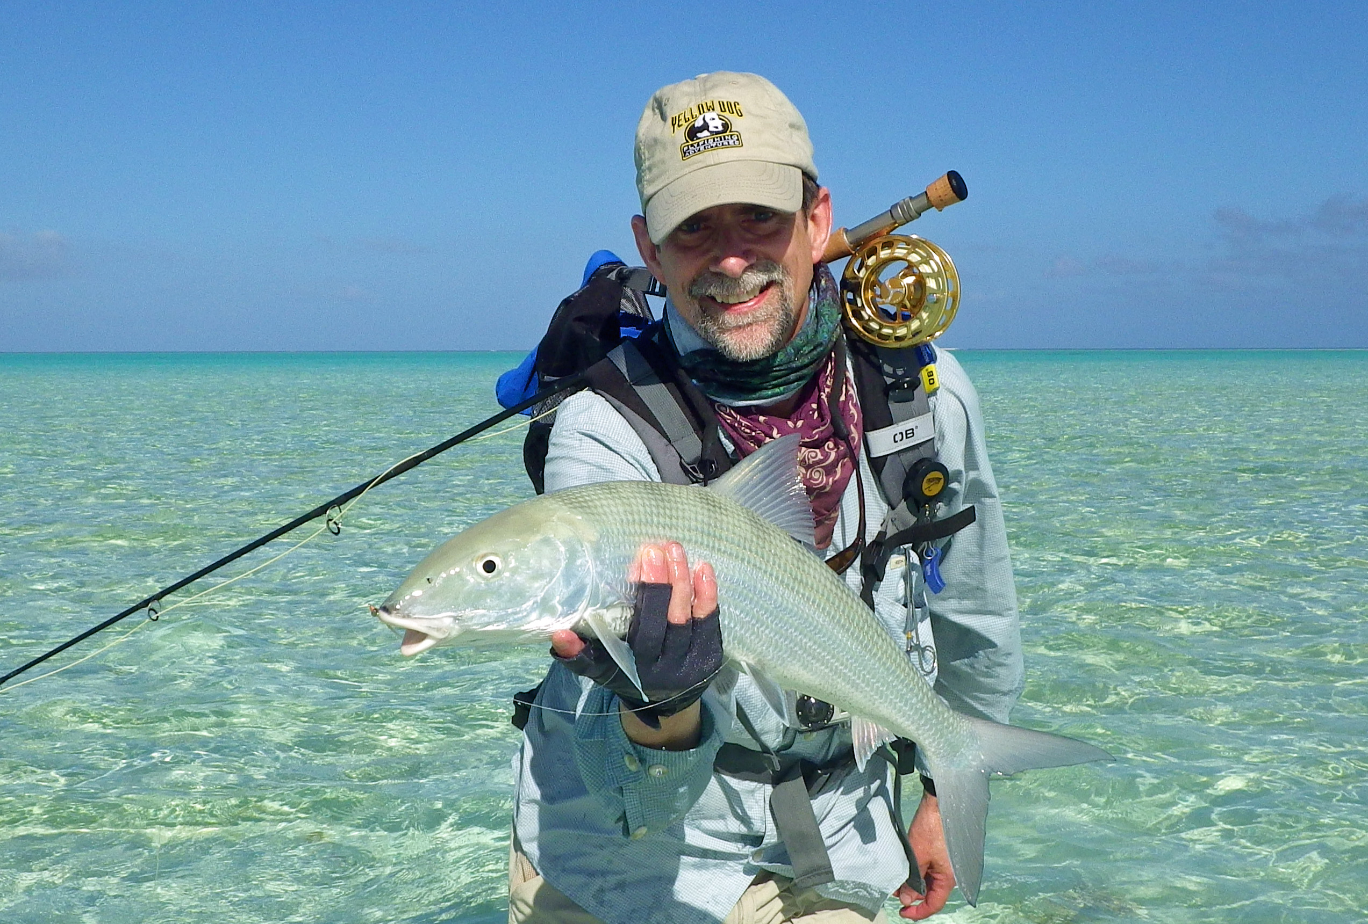
Informed Refusal
Inform patient of the risks and consequences of refusing dental care
Document warnings in chart
Request that the patient sign an informed refusal form

Slide 30
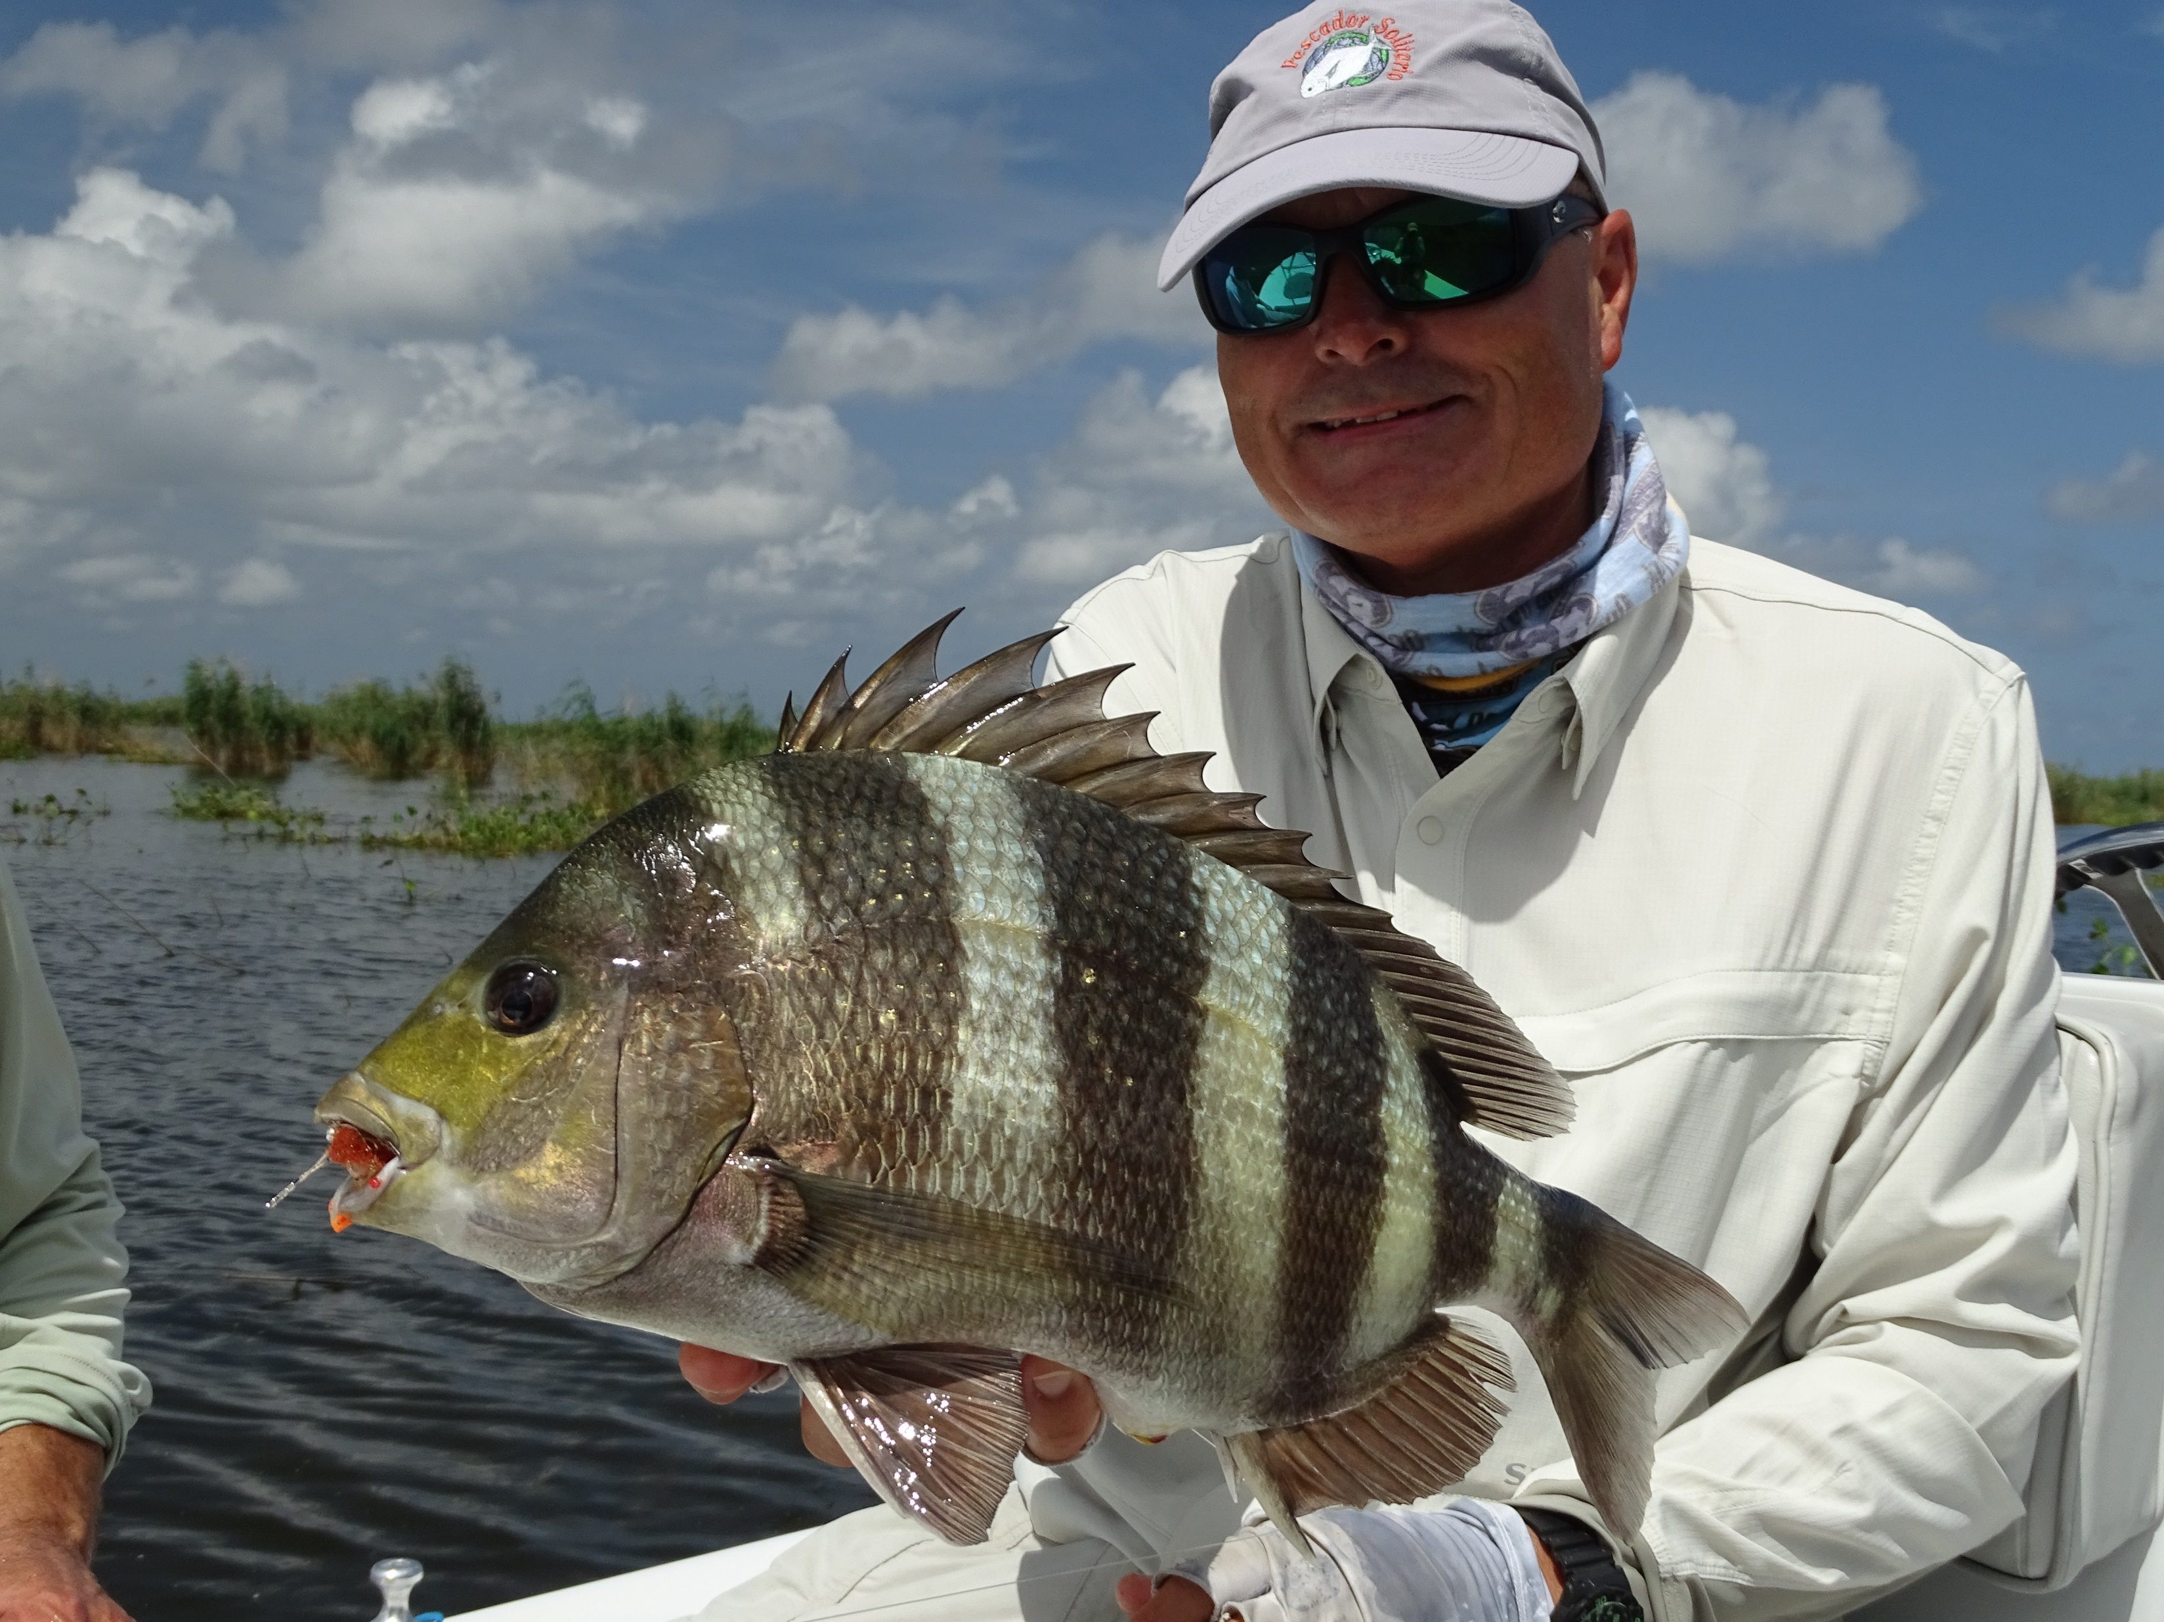

Slide 31
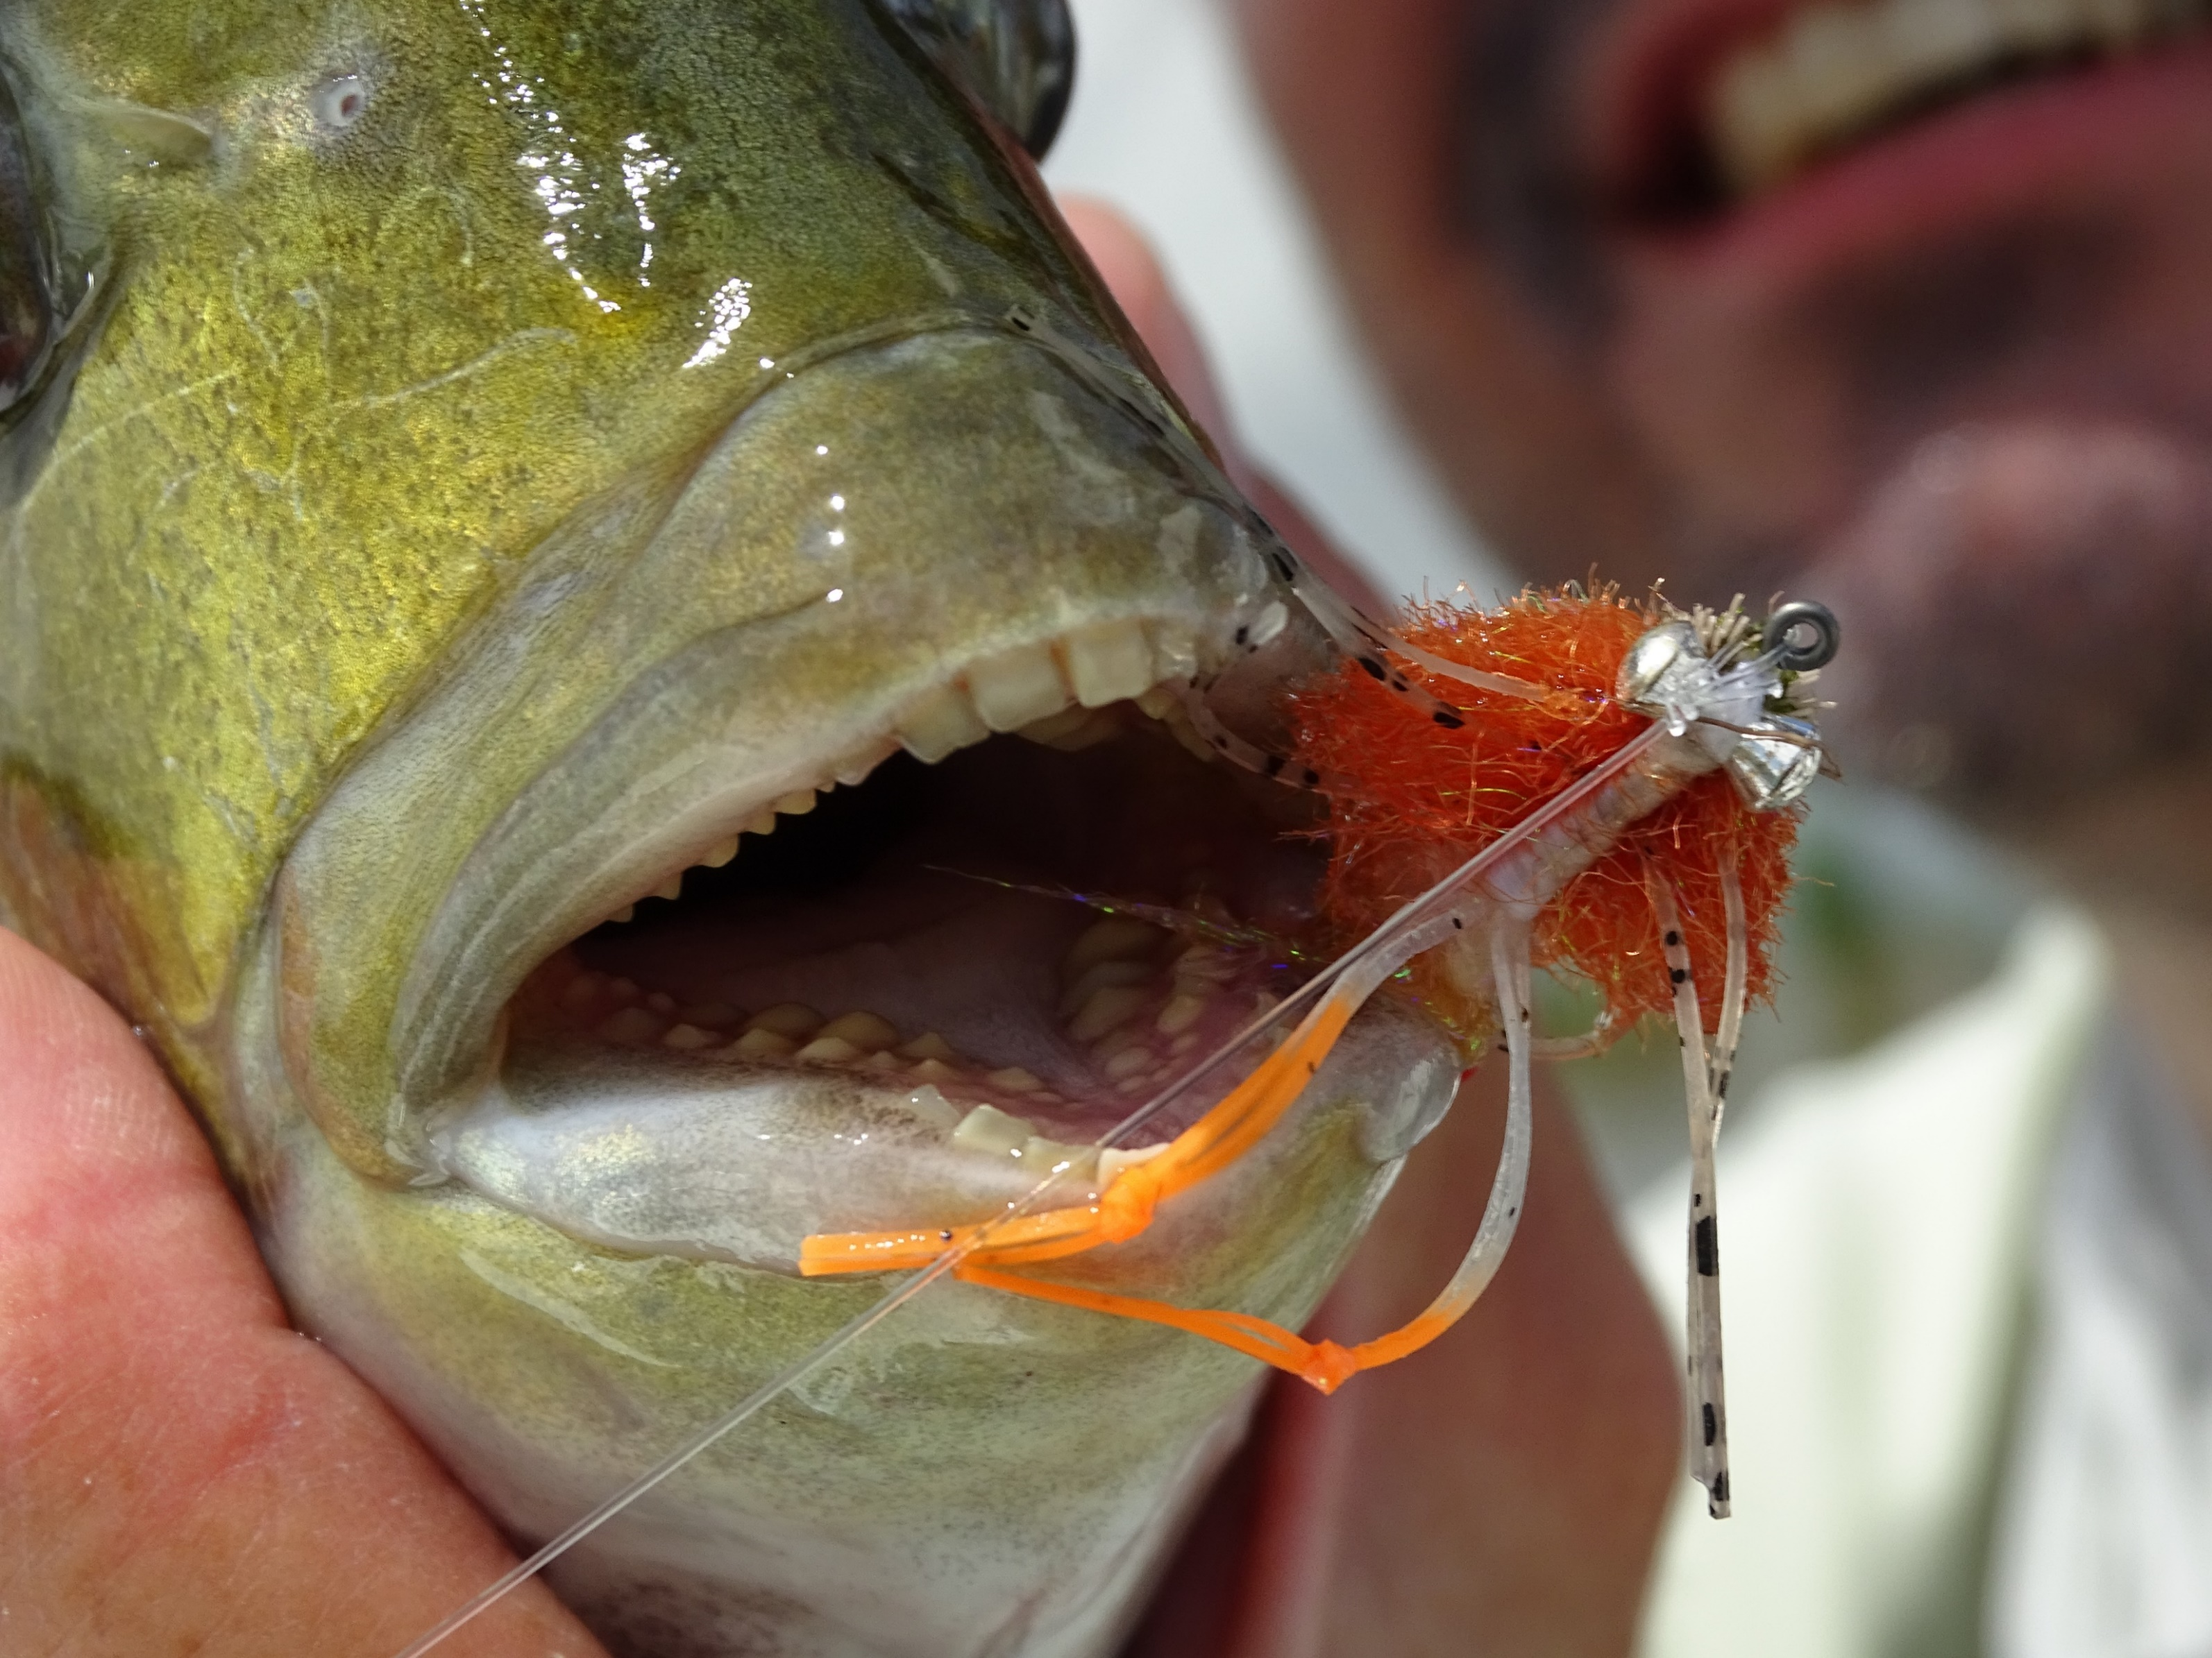

Slide 32
Record Keeping - The Law
OAR 818-012-0070 Patient Records.
(1)Each licensee shall have prepared and maintained an accurate and legible record for each person receiving dental services, regardless of whether any fee is charged. The record shall contain the name of the licensee rendering the service and include:
(a)Name and address and, if a minor, name of guardian;
(b)Date description of examination and diagnosis;
(c)An entry that informed consent has been obtained and the date the informed consent was obtained. Documentation may be in the form of an acronym such as “PARQ” (Procedure, Alternatives, Risks and Questions) or “SOAP” (Subjective Objective Assessment Plan) or their equivalent.

Slide 33
Record Keeping - The Law
OAR 818-012-0070 Patient Records.
(d)Date and description of treatment or services rendered;
(e)Date, description and documentation of informing the patient of any recognized treatment complications;
(f)Date and description of all radiographs, study models, and periodontal charting;
(g)Health history; and
(h)Date, name of, quantity of, and strength of all drugs dispensed, administered, or prescribed.

Slide 34
Record Keeping - The Law
OAR 818-012-0070 Patient Records.
(2)Each licensee shall have prepared and maintained an accurate record of all charges and payments for services including source of payments.
(3)Each licensee shall maintain patient records and radiographs for at least seven years from the date of last entry unless:
(a)The patient requests the records, radiographs, and models be transferred to another licensee who shall maintain the records and radiographs;
(b)The licensee gives the records, radiographs, or models to the patient; or
(c)The licensee transfers the licensee’s practice to another licensee who shall maintain the records and radiographs.

Slide 35
Record Keeping - The Law
OAR 818-012-0070 Patient Records.
(4) When a dental implant is placed the following information must be given to the patient in writing and maintained in the patient record:
(a) Manufacture brand;
(b) Design name of implant;
(c) Diameter and length;
(d) Lot number;
(e) Reference number;
(f) Expiration date;
(g) Product labeling containing the above information may be used in satisfying this requirement..

Slide 36
Record Keeping - The Law
OAR 818-012-0070 Patient Records.
(5)When changing practice locations, closing a practice location or retiring, each licensee must retain patient records for the required amount of time or transfer the custody of patient records to another licensee licensed and practicing dentistry in Oregon. Transfer of patient records pursuant to this section of this rule must be reported to the Board in writing within 14 days of transfer, but not later than the effective date of the change in practice location, closure of the practice location or retirement. Failure to transfer the custody of patient records as required in this rule is unprofessional conduct.

Slide 37
Record Keeping - The Law
OAR 818-012-0070 Patient Records.
(6)Upon the death or permanent disability of a licensee, the administrator, executor, personal representative, guardian, conservator or receiver of the former licensee must notify the Board in writing of the management arrangement for the custody and transfer of patient records. This individual must ensure the security of and access to patient records by the patient or other authorized party, and must report arrangements for permanent custody of patient records to the Board in writing within 90 days of the death of the licensee.

Slide 38
Record Retention-Oregon
Sterilization: Weekly Documentation (3 years)
Oregon State Law: Maintain complete treatment records (7 years)
  Including:
    X Rays
    Treatment Plans
    Patient Charts
    Patient Histories
    Correspondence
    Financial Data
    Billing
    Lab Rx

Slide 39
Record Retention (cont’d)
The Dentist Program Guidelines/Recommendations:
10 years from date of last treatment (inactive)
6 years from date of death
21 years from birth of child if treatment was provided to an expectant mother
10 years for appointment books (physical and electronic)
Keep potentially litigious patient records indefinitely

Slide 40
Record Keeping Errors
Most common charting mistakes
  Not noting PARBQ (Informed Consent)
  Leaving out the DX
  Failure to document Rx
  Not documenting shortfalls in treatment
    Not documenting follow-up efforts when there were treatment shortfalls
    The dentist should do the follow-up
  Insufficient information
  Medication issues
  Incomplete or missing entries
  Phone calls not charted
  Patient instructions not documented
  Delayed charting

Slide 41
Record Keeping Errors (cont’d)
Self-inflicted wounds – Common Mistakes
  No record of care to staff/family (Treat them like all other patients)
  Not keeping accurate track of CE accomplishment including BLS/CPR and medical emergencies
  No health history or updates
  No diagnosis
  No record of Rx
  Changing the record after you gave out a copy
  Patient noncompliance not charted
  Patient response to treatment not charted
  Lack of a treatment plan
  Failure to perform or document Oral Cancer Screen

Slide 42
Lawyers Charting Rules
If it was not recorded, it was not done.
If it was not recorded, it was not important.
If it was not recorded, it was not considered.
If it was not recorded, it was not within the standard of care.

Slide 43
Documentation
All chart entries should be dictated and transcribed or legibly handwritten, dated and signed with the writer’s full name or the first two initials and last name.
Recommend documenting all providers involved in the procedure.
Use standard charting format.
Entries should be comprehensive enough to demonstrate clinical rationale for treatment.
Use diagrams where appropriate to note size and locations of physical findings or lesions. Photos help.
Chart type/amount of anesthetic used and the patient’s response.
Record entries as close to the time of service as possible and file in chronological order.

Slide 44
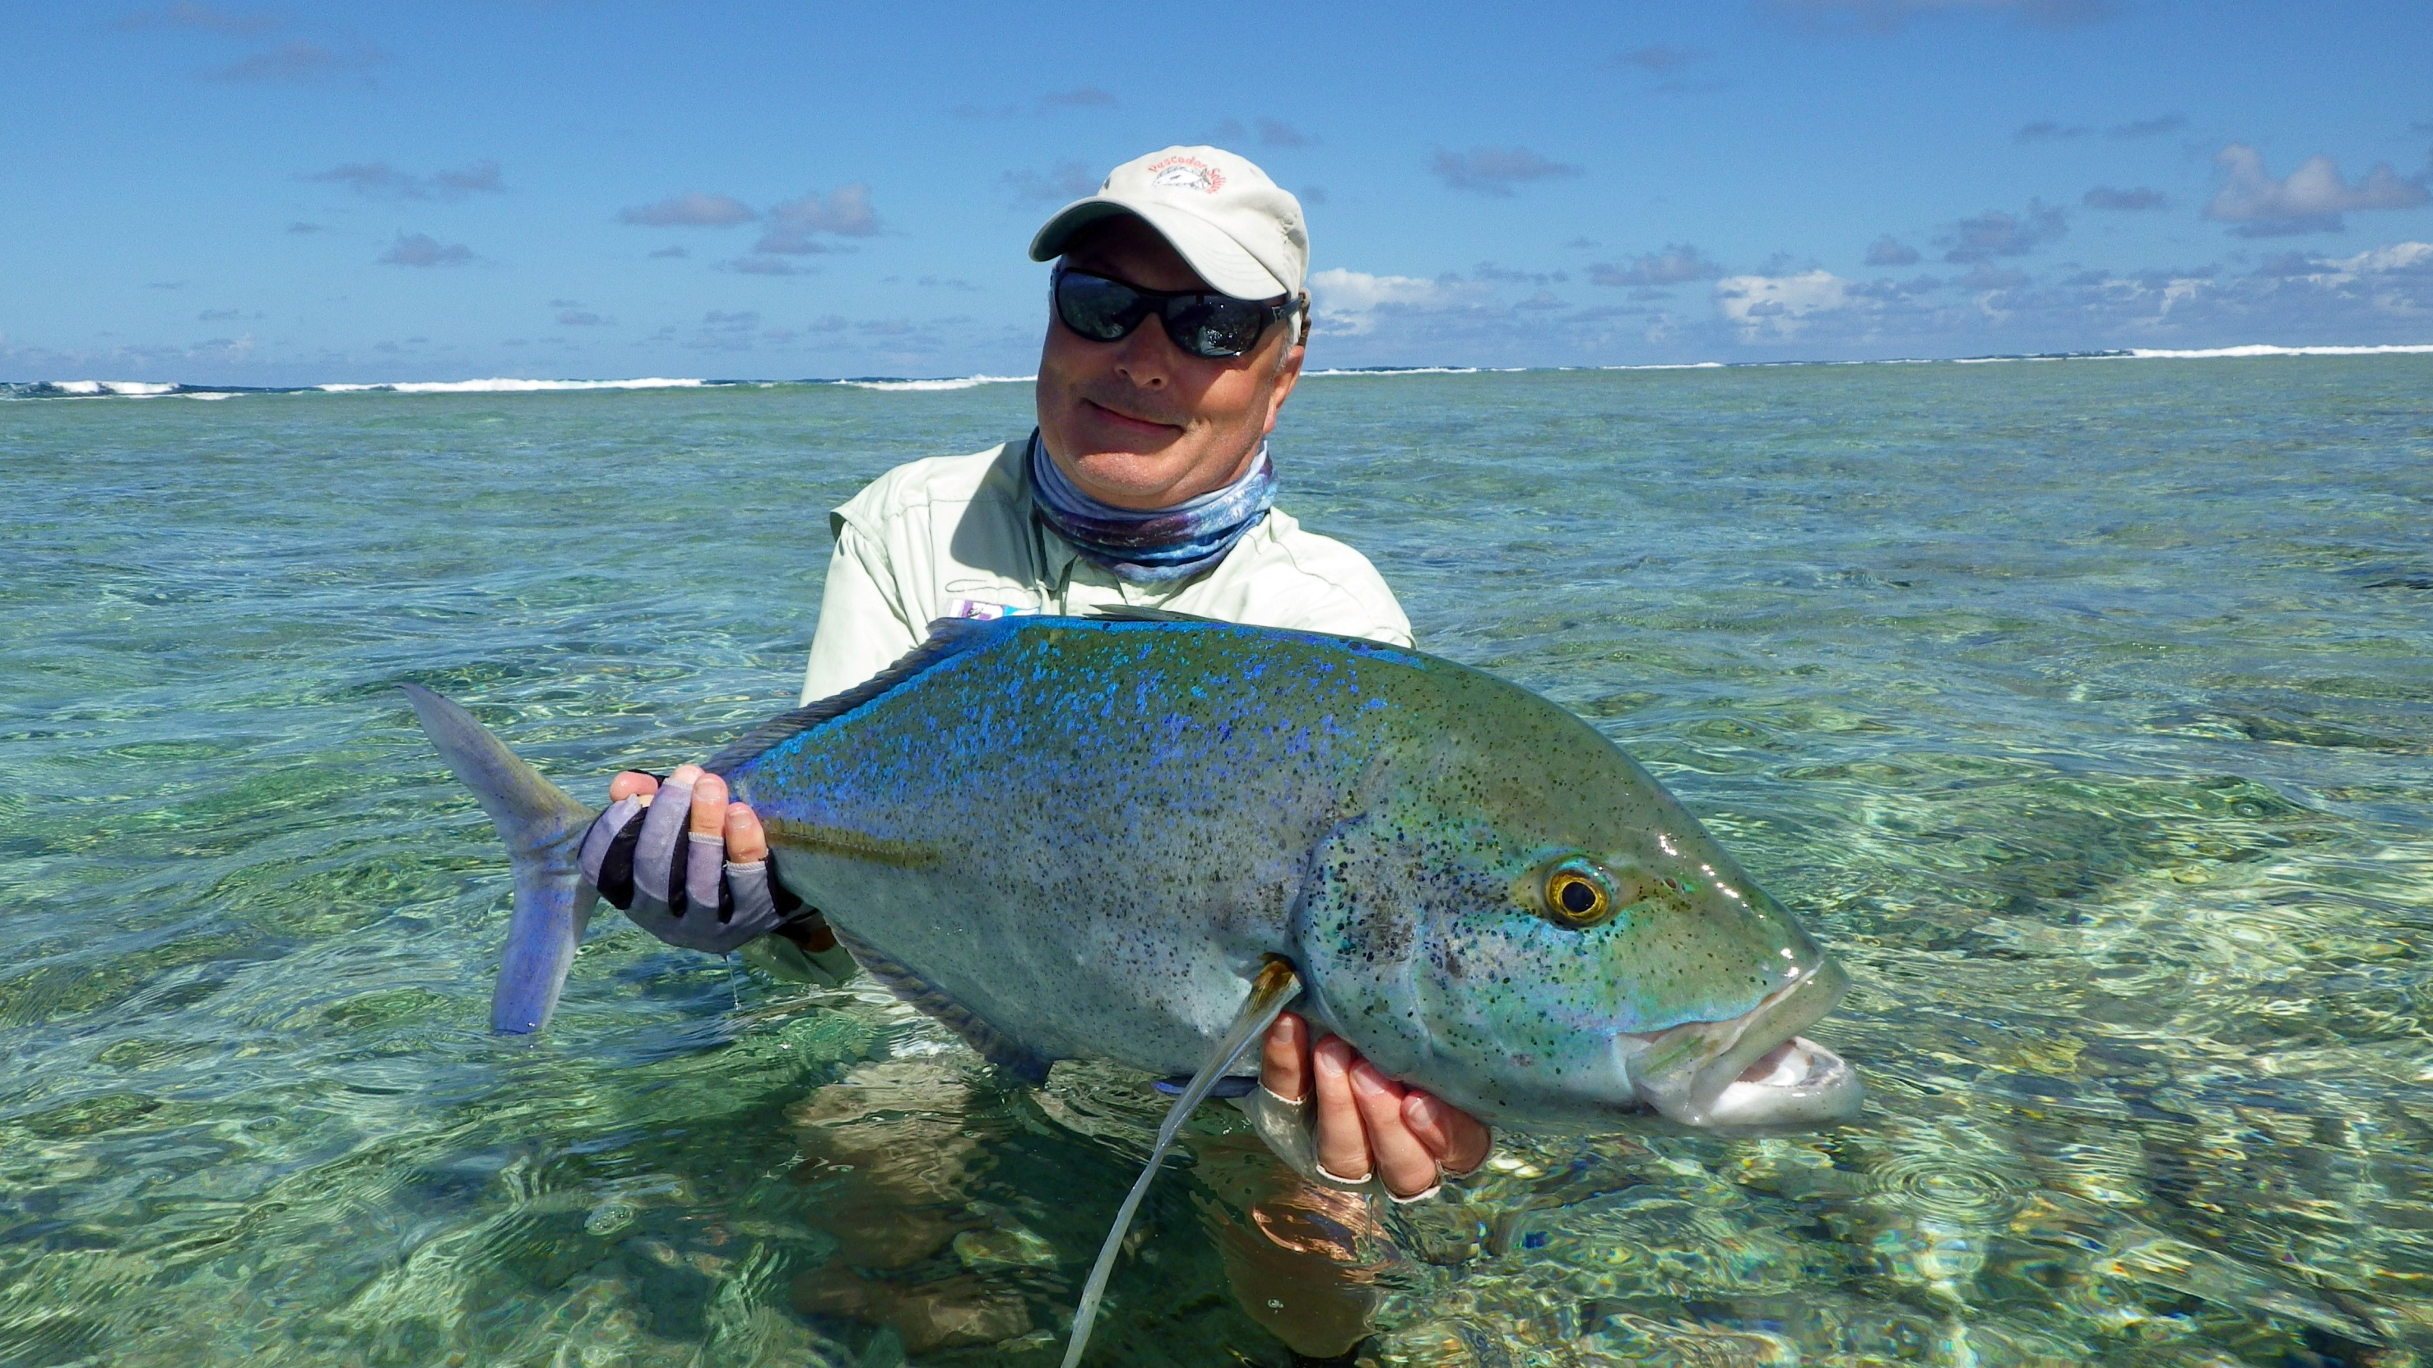
t

Slide 45


Slide 46
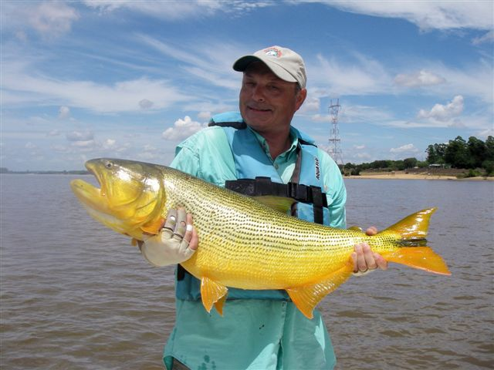

Slide 47
Documentation (cont’d)
Drug allergies are conspicuous
Problem lists and medication flowsheets are up-to-date
Prescriptions and samples are noted
Phone calls during and after-hours are documented
Informed consent is obtained and charted
Patient education, instructions and recommendations for follow-up care are documented
Return dates are included
Patient noncompliance is charted
Information is factual

Slide 48
Documentation (cont’d)
Blanks and check boxes are filled in
Oral cancer screens documented
If using paper records
  Entries are permanent (no pencils)
  Write legibly
  Don’t write in the chart margins
  Late entries in the chart are identified as such
  Avoid leaving spaces
  Don’t use Post-It Notes
Notes:
late entry may also be added as an addendum that you will talk more about in a few minutes.

Slide 49
Documentation (cont’d)
List patient name on every page in chart
Add any additional info after last entry
Don’t squeeze it in the prior notes
Patient complaints and how they are addressed are documented
Avoid any disparaging remarks
CONSISTENCY!!!!

Slide 50
Documentation (cont’d)
Include:
  Charts, referral, test results, correspondence with specialists, lab slips, and prescriptions
  Good idea to document patient’s chief complaint (if any) for each visit
How much?
  Enough to allow anyone with similar training/experience to understand treatment provided/planned and why

Slide 51
Correcting Chart Errors
If the chart needs to be corrected, the proper way to do so is by drawing a single line through the error, adding the correction, and dating and signing the change.
  For electronic records make addendum entry indicating date being corrected
If information was omitted, an addendum may be added after the most recent chart entry. You should never obliterate, cut out, erase, overwrite, or squeeze words into an existing chart entry. By doing so, you run the risk of alleged fraudulent chart tampering.
Entry in wrong chart: strikethrough and write ”Wrong Chart” date/sign
  For electronic records make addendum entry noting wrong chart

Slide 52
What Not to Document
Personal opinions about the patient
  “Patient is a malicious liar and a drug addict”
  “She is one of my most challenging patients”
  “Patient came in drunk again today”
Negative comments regarding the care of other providers
  “I can’t imagine why he was started on that medication”
  “Care previously rendered to this patient not up to the standards of this office”
  “I can not consider them qualified to assume responsibility for my patients”

Slide 53
What Not to Document (cont’d)
Administrative complaints and operational matters
  “Patient was sent to collections without my knowledge”
  “Dictation once again lost by our incompetent transcription service”
  “Patients scheduled too closely - not able to fully address patient’s concerns today”
Keep in mind
  If it’s in the chart, it’s discoverable

Slide 54
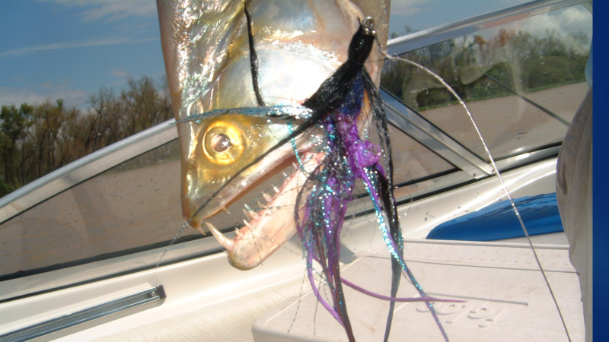
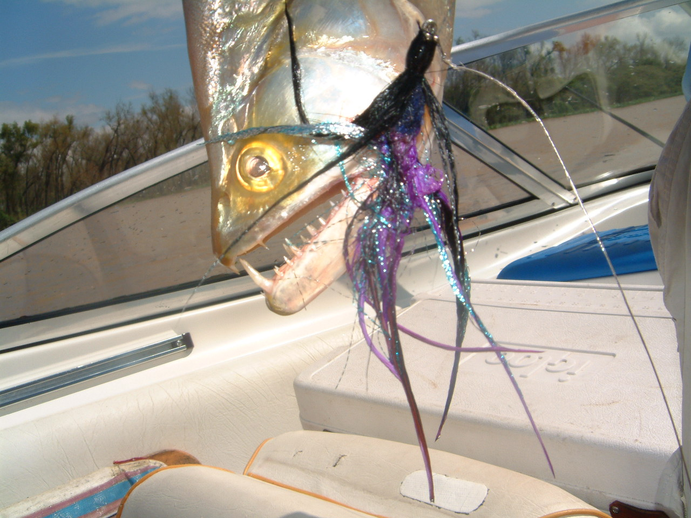

Slide 55
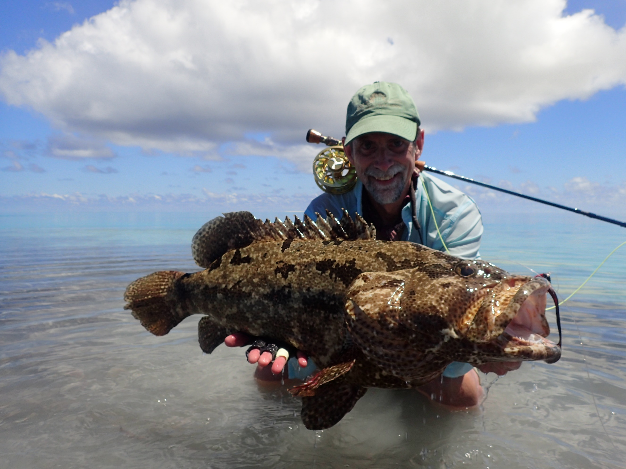

Slide 56
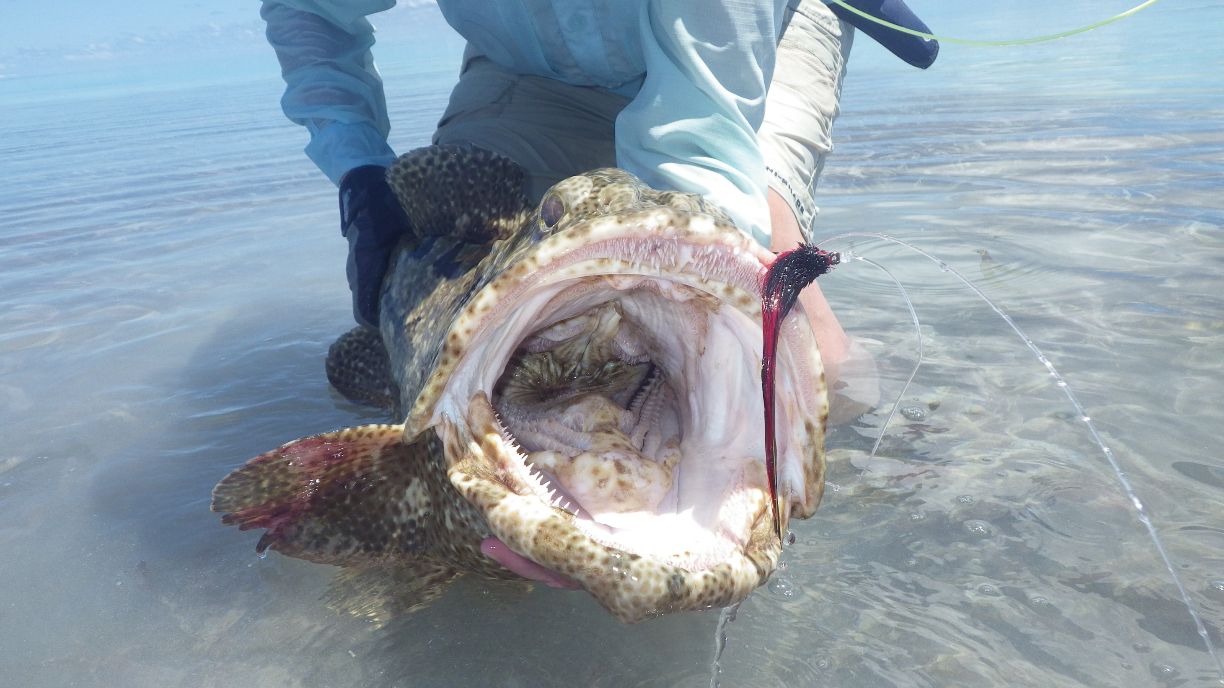

Slide 57
If You Suspect a Claim
Are matters involving risk prevention activities and matters having legal implications omitted?
Keep a separate file of legal documents, correspondence with your professional liability insurance company, attorneys, etc.
Give the original records to your attorney
Don’t talk to the patient or plaintiff’s attorney on the telephone
Don’t treat the patient who is suing you
  Exceptions: Emergency care, must complete a procedure that was already started.
Don’t conduct the trial in the chart

Slide 58
Liability Theories
Negligence/standard of care
Informed consent was not obtained
Breach of promise/didn’t meet expectations

Slide 59
Example cases
Staff error in preparing referral slip-wrong tooth extracted
RCT on wrong tooth- dysfunctional work environment, chart alterations
Paresthesia following third molar extraction- follow up delay
Paresthesia with Articaine

Slide 60


Slide 61
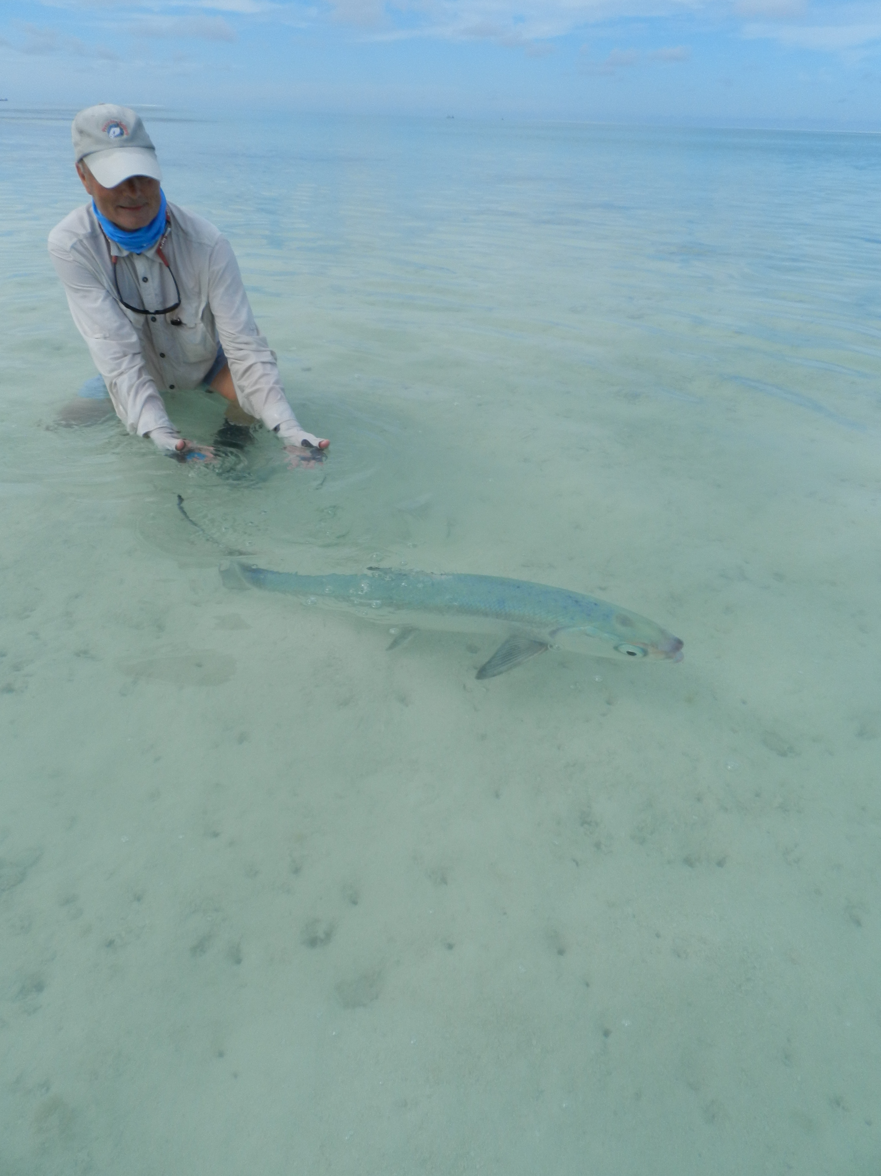

Slide 62
Standard of Care
What a reasonably prudent dentist would have done under similar circumstances
A general dentist is held to the specialist’s standard of care when:
  A procedure is attempted and the available or known evidence suggests that it should only have been performed by a specialist
  Insists on completing a procedure where:
    Complications arise which are best handled by a specialist
    Continuing the procedure (when circumstance allows the work to be stopped without serious complications to the patient) and not referring patient to the specialist to complete.

Slide 63
Handling Patient Complaints
Office Environment Matters
Good patient rapport
  Good patient rapport can mitigate dissatisfaction. Positive and caring communication is the single most effective mechanism to prevent patient dissatisfaction. Doctors and staff that are pleasant and empathetic, follow up in a timely manner, are accessible, and provide answers can often diffuse a difficult situation.
Effective communication skills
  Effective communication skills can protect your dental practice. Treat every patient with respect, compassion and candor and practice the art of listening, especially as part of the informed consent process. Ensure your staff practice the same communication style.

Slide 64
Handling Patient Complaints – Good Patient Rapport
Patients perceive staff as approachable, sympathetic and understanding
Dental, medical and financial information about patients cannot be overheard or read by other patients
Staff members refer all patient complaints about dental care to the dentist/office manager immediately
Follow up calls the afternoon or evening after appointments

Slide 65
Handling Patient Complaints – Effective Communication Skills
The office communicates with patients in a professional manner
Patients' questions are answered to their satisfaction
The dentist always discusses the treatment plan with the patient
Patients with complaints are invited to discuss their concerns in person rather than by phone
Angry or frustrated patients are not ignored

Slide 66
Strategies For Patient Complaints
Have written office policy
  All complaints immediately referred to Dr. Large group may have another central individual.
Acknowledge patient’s concern and appoint or have Dr. address same day if possible
Dr. examine patient with complaint not staff
Take patient to a “neutral corner”
Remain calm and let patient “vent”
Follow through on promises made

Slide 67
Language
Thank you for letting us know your concern. We always put our patients first. I know the Dr. would like to help you with your concern. May I arrange for the Dr. to call you back?
I’m sorry you are having some discomfort after your filling. The doctor definitely would like to take a look at that for you. Are you able to come in today at…?

Slide 68
Problem Management/Error Disclosure
Fully inform the patient ASAP
Be open and available
Be honest
  Review your findings
  Review possible future issues
Demonstrate empathy
Avoid blaming others
Discuss a plan to mitigate the issue
Ensure the patient understands

Slide 69
Problem Management/Error Disclosure
Develop a plan for follow-up
  Set up follow-up appointments before patient leaves
Encourage patient to call if there is any change
  Recommend the Dr. call the patient the evening of the incident
Apology
Use Dental Practice Event Management Checklist/Claims Reporting Process form
DOCUMENT!!!!

Slide 70
Apology
Expression of sympathy and regret
Enhances trust in the dentist patient relationship
RCW 5.64.010 – cannot use the apology in civil action against health care provider
  Apology must be within 30 days of HCP discovering error

Slide 71
Apology
ORS 679.549 Expression of regret or apology.
(1) For the purposes of any civil action against a person licensed by the Oregon Board of Dentistry or against a dental office or clinic, health care institution, health care facility or other entity that employs or grants the person privileges, any expression of regret or apology made by or on behalf of the person, office, clinic, institution, facility or entity, including an expression of regret or apology that is made in writing or by conduct, does not constitute an admission of liability.
(2) A person licensed by the board, or any other person who makes an expression of regret or apology on behalf of a person licensed by the board, may not be examined by deposition or otherwise in any civil or administrative proceeding, including any arbitration or mediation proceeding, with respect to an expression of regret or apology made by or on behalf of the person, including expressions of regret or apology that are made in writing, orally or by conduct.

Slide 72
When special conditions occur, special rules apply
Take extra time to chart
  Draft format first
  Consult key personnel/ staff that assisted
Are all mishaps mentioned in the record?
  Must be there to protect the credibility of the record (e.g. patient cried or patient yelled

Slide 73
When to Call Your Professional Liability Company
• Death of a patient under any circumstance
Any diagnostic or therapeutic conditions resulting in injury
Incident of potential claim
Contact by an attorney
Receipt of a subpoena or suit papers
Contact by peer or state review agency

Slide 74


Slide 75
Patient Red Flags
Trouble signs
  Patient is rude to staff
  Patient tells you what treatment they need
  Patient wants special handling
  Patient terminated by prior dentist
  Patient wants care you do not provide
  Patient wants special appointments
  Patient wants special billing arrangements
  Patient misses appointments
  Something just does not feel right

Slide 76
Terminating the Patient Relationship
Possible Reasons to terminate
  Failure to follow the treatment plan
  Failure to keep appointments
  Failure to comply with referrals
  Failure to follow hygiene recommendations
  Failure to cooperate with staff
  Inappropriate behavior towards staff
  Failure to pay for services
  When the patient sues you
  Breakdown of the Dr.-Patient relationship

Slide 77
Terminating the Patient Relationship (cont’d)
Before discharging a patient consider the following:
  Discrimination issues
  Managed care or other contracts
  Medicare/Medicaid recipient
  Legal ability to make health care decisions (minor, dementia, etc)
Other things to consider:
  Patient’s current condition
  Availability of other providers to care for the patient
  Method of notifying the patient

Slide 78
Terminating the Patient Relationship (cont’d)
To avoid abandonment issues, you should not terminate care in the middle of treatment
  RCW 18.32.683 The attending dentist, without reasonable cause, must not neglect, ignore, abandon, or refuse to complete the current procedure for a patient
  If the dentist chooses to withdraw responsibility for a patient of record, the dentist shall:
  (a) Advise the patient that termination of treatment is contemplated and that another dentist should be sought to complete the current procedure and for future care; and
  (b) Advise the patient that the dentist will remain reasonably available under the circumstances for up to fifteen days from the date of such notice to render emergency care related to that current procedure.
Patient care best terminated once the treatment, or a phase of treatment has been completed

Slide 79
Terminating the Patient Relationship (cont’d)
When a licensee terminates the provider-patient relationship, the licensee must provide appropriate written notice to the patient or the patient's representative sufficiently far in advance (at least 30 days) to allow other medical care to be secured. The written notification should indicate resources that might assist the patient in establishing care with a new provider; however, the discharging licensee is not required to refer the patient to a specific provider or practice. The licensee must ensure that the patient has access to their medical records, and the notice should instruct the patient on how to obtain or transfer those records to their new health care provider. When possible, the letter to the patient and/or to the patient's responsible party should include the reason for ending the provider-patient relationship, but the decision to provide or not provide that explanation is up to the licensee and may be dependent upon the situation.
Oregon Medical Board
https://www.oregon.gov/omb/board/philosophy/pages/ending-the-patient-physician-relationship.aspx

Slide 80
When You Terminate the Relationship
Notify the patient in writing and document in record
Offer emergency care for 30 days
Include local referral sources in letter to patient
Offer to forward a copy of the patient’s dental record to the new provider
Consider discussing risks of not seeking treatment
Send letter by certified mail, return receipt requested
Place copy of letter and delivery receipt into patient’s chart
If letter returned unclaimed, send copy of letter through normal mail route and document the same
Notify the staff
Do not take the patient back

Slide 81
Sample Termination Letter
Date
Dear Mr/Ms
This is to inform you that your treatment is being discontinued due to failure to follow through with recommended treatment. I regret that this action is necessary, however I am willing to see you on an emergency basis during the next 30 days while you find a substitute source of treatment. Copies of your dental records will be provided to you or your new dentist upon receipt of a signed and dated written request from you. We have release forms available.
You are reminded that your last examination on ( ) you were diagnosed with periodontal disease. Initial scaling and root planning was completed on ( ) and periodontal maintenance appointments were recommended every three months as part of the periodontal treatment regime. As I have not had a chance to examine you in over a year, I cannot comment on your current oral health condition. Failure to seek treatment may result in increased risks of dental disease that could shorten the life span of your restorations as well as the teeth themselves.
I will be glad to consult with your new dentist regarding your dental needs at any time in the future. If you need help in finding a new dentist you can call the Seattle-King County Dental Society at 206-443-7607.
Sincerely,

Slide 82
Refunds
Are not an admission of guilt
Are not reportable to the NPDB
  Exception: Peer review refund from corporation
Deflect a potential claim or Board complaint
Patient should sign a release form
  Negotiated amount
  Confidential
Must also reimburse any payments from Dental Benefit plans

Slide 83
Collections
Doctor must be notified before patient sent to collections
  May want to personally discuss with patient
Avoid letting balances become too large
Frequently lead to complaints

Slide 84
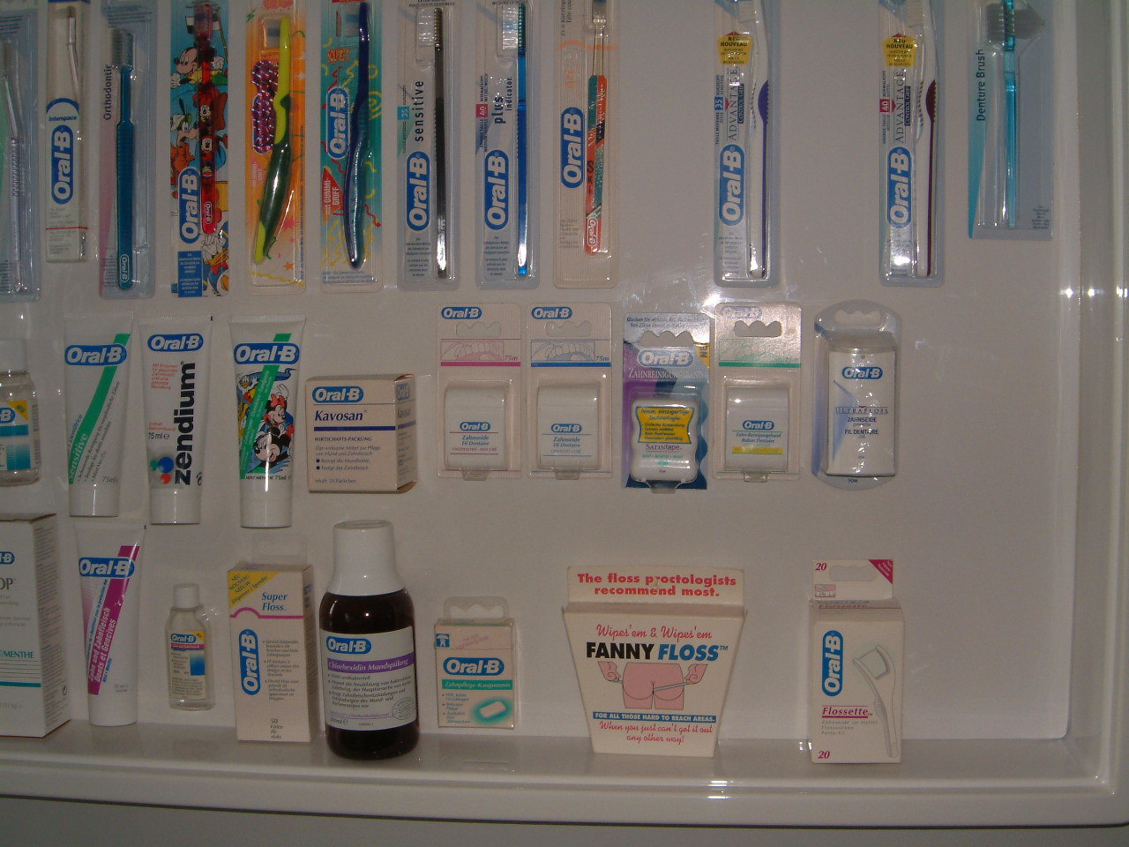
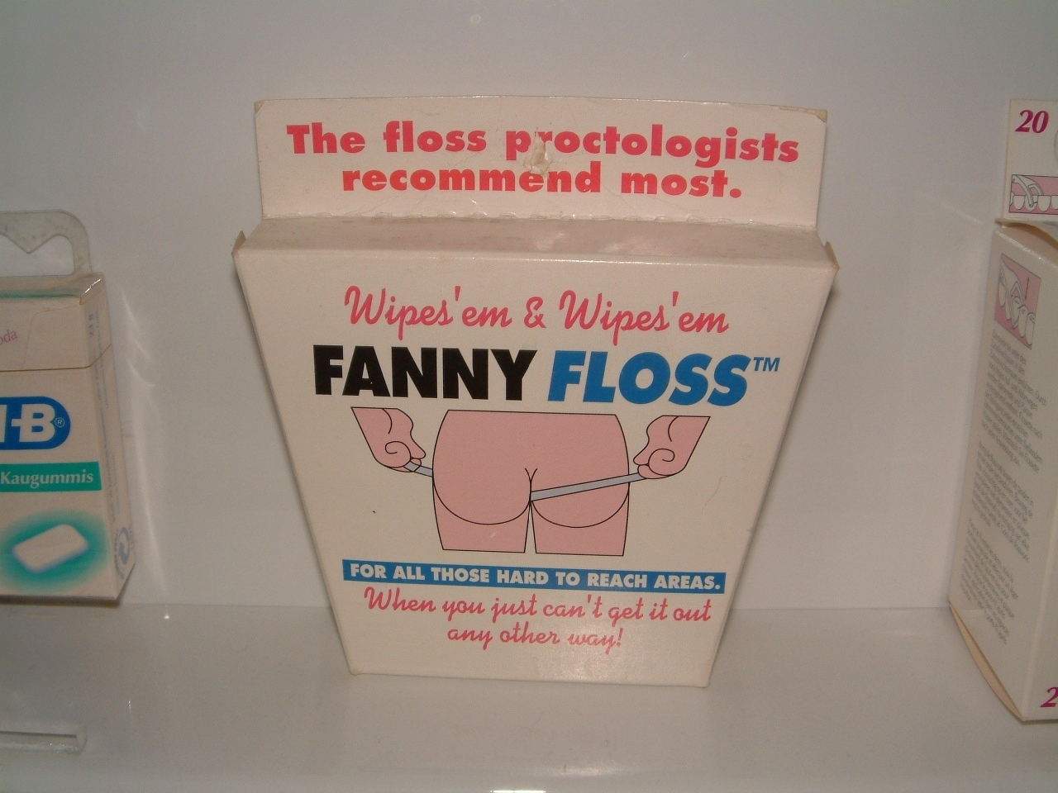
The End

